Slide 1


Leadership, Values, and Mindful Self-compassion
Jane Boswick-Caffrey & David Bond
October 27, 2023
DRAFT 10.26.23
Notes:
Image from Getty Images

Slide 2

Centering

Slide 3
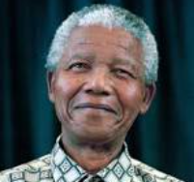
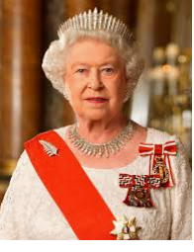
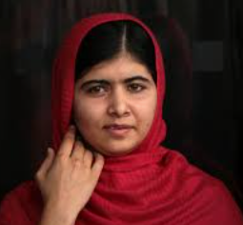
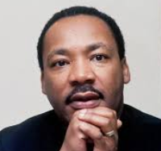
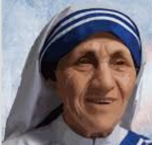
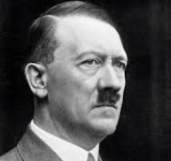
Exemplary
Leaders
Think about one of the best leaders you’ve worked with or observed – a SPECIFIC person.
What did they DO that made them good leaders?
Think of the WORST leaders you’ve worked with.
  What behaviors did this person exhibited.
  What was the IMPACT on you and the team.

Slide 4

Values are the BASIS for keeping you GROUNDED on a path of being your BEST SELF.
Values are your OPERATING PRINCIPLES - that form your belief system.
Why are Values Important?
Values are the FOUNDATION of who you are as a leader. Getting CLARITY is an important first step.
People around you know what they can expect from YOU and what you expect from THEM.
Notes:
Values are the BASIS for keeping you GROUNDED on a path of being your BEST SELF.
Values are your OPERATING PRINCIPLES - that form your belief system….. You take them wherever you go.
Values are the FOUNDATION of who you are as a leader. Getting CLARITY is important first step.
Today - well help you IDENTIFY and DEFINE the values which are most important to you.
Values serve as a COMPASS to guide us. They help us know what’s right as we make DECISIONS,
Values embody our CULTURE and BEHAVIORAL expectations for every individual, regardless of their entity or profession, within the health system.
So the values are not something to add to our collective ‘to do’ lists but rather something to LIVE through our daily ACTIONS, BEHAVIOIURS, DECISIONS.
Values are the BASIS for keeping you GROUNDED along a path of CONGRUENT leadership.
That’s what we’ll do together – help you all IDENTIFY, and DEFINE the values which are most important to you.

Slide 5

Values in
Conflict
Think about a time when you were “triggered”
Better self-awareness promotes better self-management
Examples of values in conflict
Notes:
When you are triggered by someone else – it’s usually because one of your values is feeling violated/questioned.
BETTER self awareness promotes better self-management.
Better self management allows you to bring our best self forward.
Another reason why awareness of your values can help you with emotional self-awareness.
Sharing Definitions of your values is essential….
Explore: pick one value where you are in conflict either with one of your own values or with those around you.
Jane – Example: Loyalty, Accountability – often my loyalty and accountability can be in conflict when someone I care about doesn’t meet an agreement.
Accountability – often is in conflict with others when I realize expectations may not be aligned.
Loyalty – “undying” or are do you show loyalty by holding up mirror?

Slide 6
Clearly articulating your values helps others know what to expect.
Provides basis for conversation when conflict arises.
Brings awareness to what matters most.
Crafting your Leadership Beliefs – aka Value Statements
Notes:
Values are the BASIS for keeping you GROUNDED on a path of being your BEST SELF.
Values are your OPERATING PRINCIPLES - that form your belief system….. You take them wherever you go.
Values are the FOUNDATION of who you are as a leader. Getting CLARITY is important first step.
Today - well help you IDENTIFY and DEFINE the values which are most important to you.
Values serve as a COMPASS to guide us. They help us know what’s right as we make DECISIONS,
Values embody our CULTURE and BEHAVIORAL expectations for every individual, regardless of their entity or profession, within the health system.
So the values are not something to add to our collective ‘to do’ lists but rather something to LIVE through our daily ACTIONS, BEHAVIOIURS, DECISIONS.
Values are the BASIS for keeping you GROUNDED along a path of CONGRUENT leadership.
That’s what we’ll do together – help you all IDENTIFY, and DEFINE the values which are most important to you.

Slide 7
Jane’s Value Statement
Three of my core values are Teamwork, Fairness, and Accountability.
How this shows up for me is that I have a strong preference to work in a collaborative team environment, where everyone is treated equally, listened to, and contributes to the team goals. If I tell you I’ll do something – I’ll do it, or let you know in advance and whenever possible have an alternative solution.
I find it very stressful when team members don’t honor commitments or communicate conflicts.
I am my best self in an environment that honors loyalty, accountability and has fun together.

Slide 8
Components of Values Statement
State your values (Can be one or more depending on context/purpose).
Three of my core values are Teamwork, Fairness, and Accountability.
1
Share how those values directly relate to what others can expect from you.
How this shows up for me is that I have a strong preference to work in a collaborative team environment, where everyone is treated equally, listened to, and contributes to the team goals. If I tell you I’ll do something – I’ll do it, or let you know in advance and whenever possible have an alternative solution.
2
Share what you will expect from others – through your values.
I find it very stressful when team members don’t honor commitments or communicate conflicts.
3
Let others know what environment contributes to/brings out your “Best self”.
I am my best self in an environment that honors loyalty, accountability and has fun together.
4

Slide 9
Dave’s Value Statement (UBUNTU)
1
Four of my core values are Respect, Curiosity, Compassion, & Courage – in Service to Others
How this shows up for me is that I have a strong preference for environments in which each person feels valued for the insights and diverse perspectives they bring. When people feel seen, heard and trusted, they tend to flow with ease into collaborative and creative spaces.
I find it very stressful when any of these features are missing – for example, in hierarchical contexts or when team members are prescriptive and directive.
I am my best self in an environment of deeply respectful awareness and connection. I believe this opens us to unexpected insights and learning.
2
3
4

Slide 10
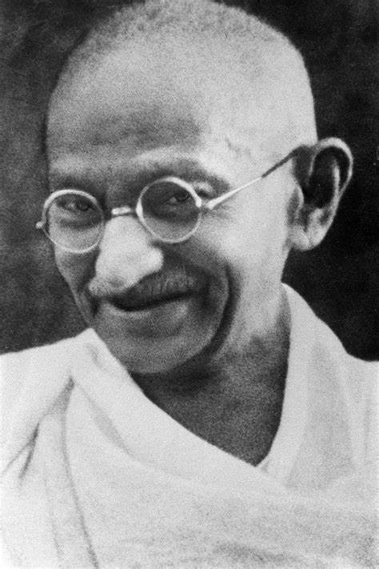

Keep your thoughts positive, because your thoughts become your words.
Keep your words positive because your words become your behaviors.
Keep your behaviors positive because your behavior becomes your habits.
Keep your habits positive because your habits become your values.
Keep your values positive because your values become your destiny.
Mahatma Gandhi
Notes:
Connect to Resilience.

Slide 11
Mindful Self-Compassion
David Bond
Notes:
Image from Getty Images

Slide 12
Relational Leadership
Mindset & Intention (Relational Values):
  Respect
  Curiosity
  Compassion
  Courage
Quality of Relationships
Quality of Conversations and Thinking
Quality of Action
Quality of Impact/ Results
(Daniel Kim)
(D.Bond)

Slide 13
Grounded Leadership requires clear awareness of our Values
Behavior out of alignment with our values, causes stress & contributes to burnout
Better self-awareness & reflection promotes better self-management
Mindful Self-Compassion offers research-based methods and practices for this
WHY MINDFUL SELF-COMPASSION?

Slide 14
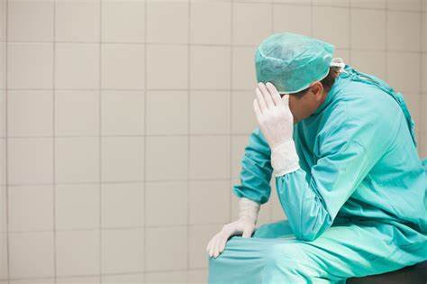
Notice our Implicit ‘Drivers’
(Socialized Values)
Be Strong
Try Hard
Please Others
Be Perfect
Hurry Up
Be Careful

Slide 15

Myths Novice Physicians Live By
Notice the ‘Stories’ that Implicitly Guide our Lives
Physicians will be all knowing
Uncertainty is a sign of weakness
The patient will always come first
Technical excellence will provide satisfaction
Patients, not physicians, need support
W. & M. Sotile: The Resilient Physician. Effective Emotional Management for Doctors and Their Medical Organization. (p 252)

Slide 16
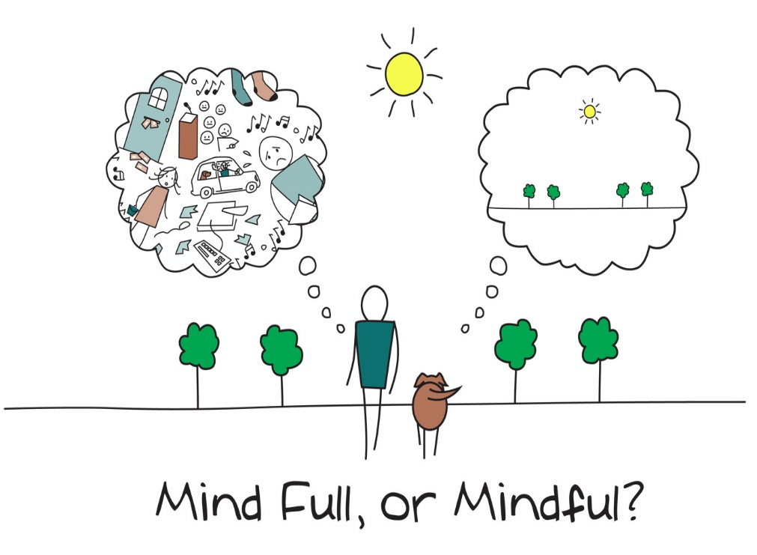
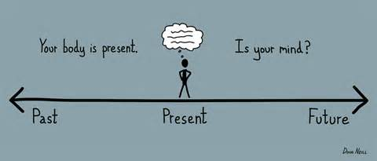
MINDFULNESS
‘noticing what’s happening, whilst it’s happening, without judgment’

Slide 17
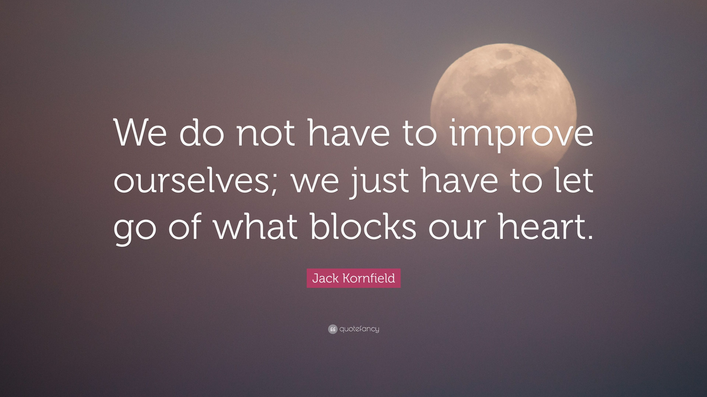
SELF-KINDNESS

Slide 18
Mindful Self-Compassion
(Neff & Germer)
Mindfulness
Self-Kindness
Common Humanity

Slide 19

PRACTICE: Fostering Habits of Mindful Self-Care
We are what we repeatedly do.
Excellence, then, is not an act but a habit.
-Will Durant
Notes:
B
3GT – noticing
1GT - noticing
Even with people you don’t know well

